Slide 1
Sudoku Solver
Guide :
Jis Joe Mathew
Team Members * Leoyon
* Mrudul
* Renuka
* Sandra
* Sreyas

Slide 2
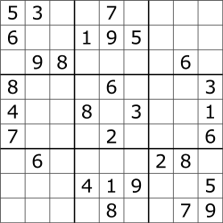

Slide 3
Abstract
Sudoku solving application scripted in python
Solve any hardcore sudoku puzzles in seconds

Slide 4
Graphical Interface
Beautiful and modern ui written in Qt
Crossplatform

Slide 5
Working
This program works on reverse backtracking algorithm

Slide 6
Reverse Backtrack Algorithm
Keeps the track of each input in stack using recursion
Whenever one of the try (inputting number to puzzle) get failed it clears it as well as the previous try
Brute forces each sudoku block until the solution is formed
Returns false boolean on invalid puzzle

Slide 7
Requirements
There is no need of additional dependencies for the binary created by the static linking of pyinstaller
For non binary version (py) only PyQt5 along with python 3.5 is needed to be installed.

Slide 8
Thank You!!!

